Slide 1


The Home Grown
The Home Made Food Destination
Introduction :
The business of Restaurant is spread all over the world. The proposed system is a window based menu driven system for Home Made Food Business that reduces paper work, time needed for doing various tasks holds the accuracy of data etc. The system stores the data of collection, eat-in, take-away, statistics. Users can choose the food item of their choice from the menu card and place order for the same. When a customer requests new cuisine, they’re provided after consulting with the team of chefs. Admin can view the statistics of the transactions in a click to keep a track of sold and purchased items as well as total profit and loss. As the famous quotation said, “Happiness is Homemade” ; we’ve come up with a way to diminish Hunger and serve food worth of it’s price
Objective :
The Home Made Food Management system is complete end to end software solution to cover all aspects of delivering healthy delicious food.
To make transactions hassle-free 24 hours, 365 days!
A User-friendly software that saves time and maintains secure and error-free database.
Building platform that ensures user satisfaction and trust.

Slide 2


Requirements Specification :
Software Requirements:
Windows Xp, Windows 7(ultimate, enterprise)
Sql Server manager 2012
Visual studio 2015
Hardware Components:
Processor – i3
Hard Disk – 5 GB
Memory – 2GB RAM
Microsoft Visual Studio is an integrated development environment (IDE) from Microsoft. It is used to develop computer programs, as well as websites, web apps, web services and mobile apps. Visual Studio uses Microsoft software development platforms such as Windows API, Windows Forms, Windows Presentation Foundation, Windows Store and Microsoft Silverlight. Language used in Programming the software is C#.

Slide 3
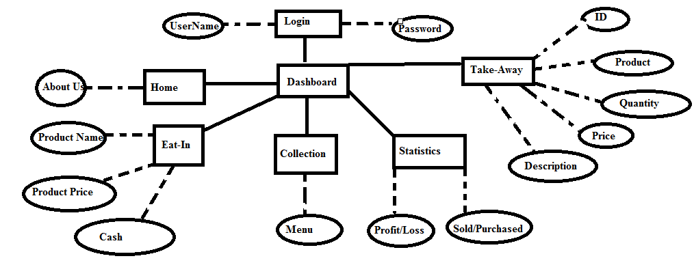
Design Phase ER Diagram:

Slide 4
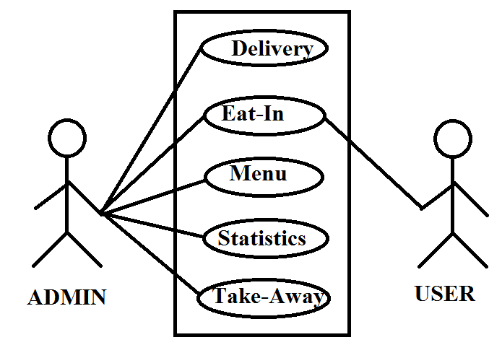
Use Case Diagram-

Slide 5
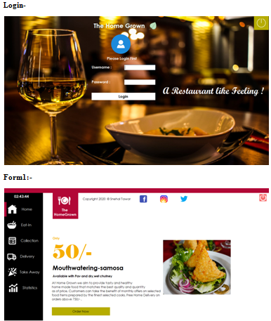
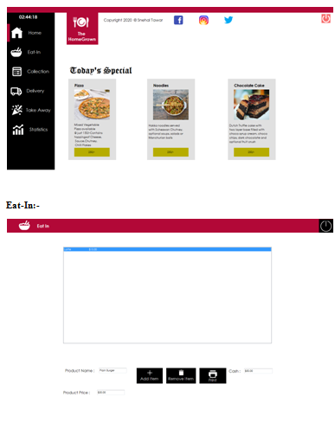
Results:

Slide 6
